Slide 1
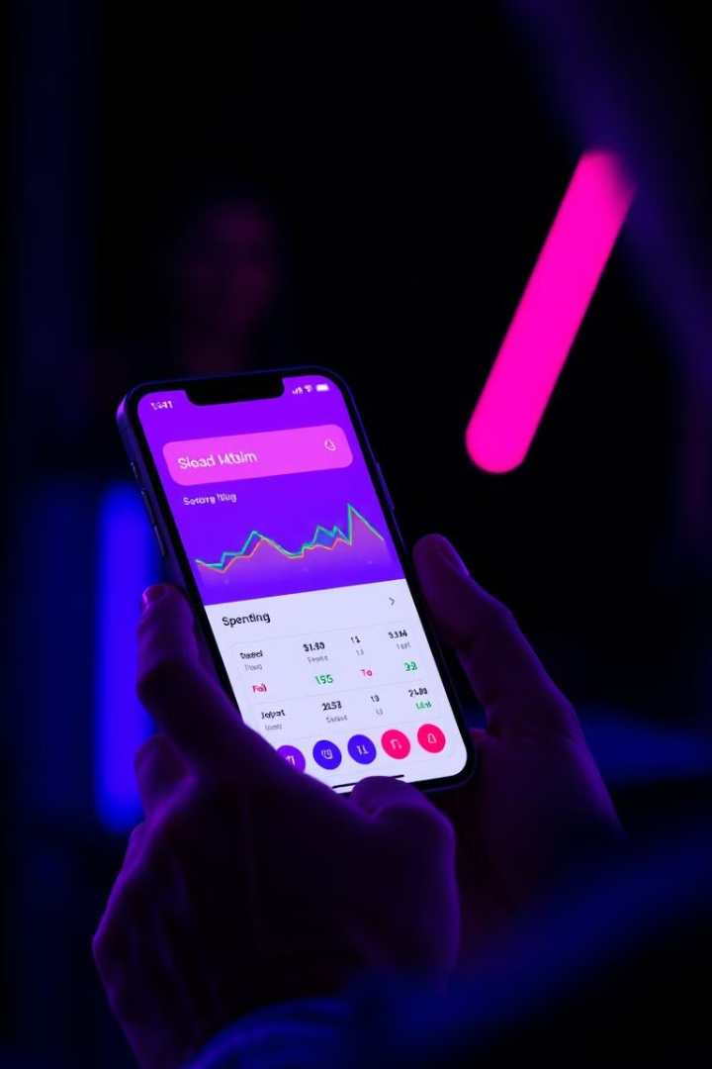
FinFlow: Your Daily Financial Buddy
FinFlow is a prospective personal finance management application designed to simplify budgeting, track expenses, and provide actionable insights through features like real-time notifications and data visualizations.

Slide 2
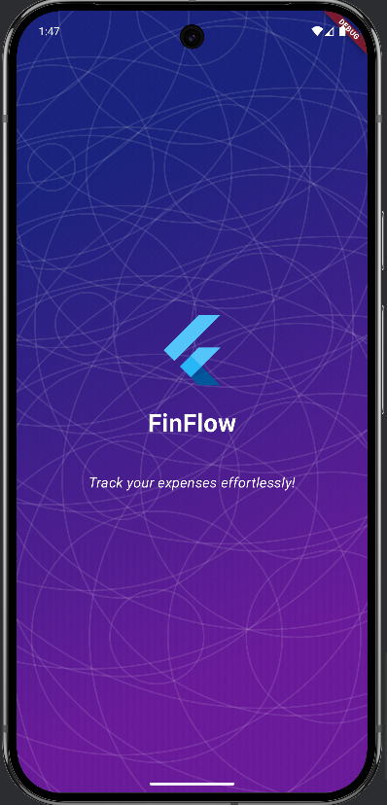


Our Team:
Khaled Mohamed
Amr Nabil
Mahmoud Youssef
Arwa Nader
Omar ElSayed
Mohamed Ashraf
18102135
19100960
19100592
19104411
211000254
211000093

Slide 3

Addressing the Need for Effective Finance Management
Managing personal finances is a critical skill, but many people struggle with maintaining budgets, tracking expenses, and understanding their spending patterns, leading to financial stress and instability.
Existing expense management tools often fall short, being either overly simplistic or too complex for the average user.

Slide 4
FinFlow's Motivation: Academic and Real-World Challenges
Academic Motivation
Real-World Motivation
FinFlow integrates concepts from computer science, software engineering, and artificial intelligence, providing a practical application of theoretical knowledge.
The app aims to improve financial literacy by providing insights into spending habits and offering personalized recommendations.

Slide 5

FinFlow's Objectives: Simplifying Finance Management
1
Expense Tracking
2
Budget Management
Provide users with an intuitive platform to track daily expenses manually or through automated methods.
Enable users to set and monitor monthly or weekly budgets for specific categories.
3
Financial Insights
4
Real-Time Notifications
Offer detailed visualizations (e.g., pie charts, bar graphs) to help users understand their spending patterns.
Alert users when their expenses exceed budget limits or when unusual spending patterns are detected.

Slide 6
FinFlow's Scope: Features and Functionality
Included Features
User Modes
Expense Entry, Category Management, Budget Setting, Visualizations, Notifications, Data Export, Expense Forecasting, Investment Recommendations.
Individual Mode, Educational Institution Mode, Small Business Mode, Financial Advisor Mode.

Slide 7
FinFlow's Significance: Academic and Practical Contributions
Academic Contributions
Practical Contributions
Practical Application of Theoretical Concepts, Research Opportunities.
Improved Financial Literacy, Budget Management, Real-Time Insights, Cross-Platform Accessibility.

Slide 8

FinFlow's System Description: Stakeholders and Goals
Customers (Individuals)
Small Businesses
Track daily expenses, view and analyze personal financial summary, receive investment or saving recommendations.
Monitor operational expenses and revenues, generate basic financial statements and reports, avoid high costs of enterprise-level financial tools.
Educational Institutions
Financial Advisors
Use the app as a teaching tool in finance, business, or computer science courses, illustrate practical application of data management, AI (for recommendations), and user experience design.
Track and review client expenses to provide better advice, recommend the tool as a supplementary method for clients to manage their personal or small business finances.

Slide 9





Data Design
User
Transaction
Budget
Notification
Stores user profile information, including username, password, and user role.
Records financial transactions, including amount, category, date, and description.
Defines budget limits and savings goals for specific categories and periods.
Manages notifications for budget alerts, expense reminders, and system updates.

Slide 10
FinFlow's System Requirements: Functional and Non-Functional
Functional Requirements
Non-Functional Requirements
Create an account and authenticate with secure credentials, add financial data using multiple methods, display a dashboard with up-to-date summaries of expenses, income, and savings goals, generate financial reports like monthly expenses, profit/loss statements, integrate with external market data APIs to offer basic investment or savings recommendations, send notifications for nearing budget limits, bill reminders, etc.. via email, SMS, or push notifications, provide user roles (e.g., individual user, small business, financial advisor).
Security: All data must be encrypted at the database level and in transferring the data using HTTPS. Performance: Key dashboard pages should load within 2 seconds under normal usage. Portability: The system shall run on major operating systems like Android and IOS.

Slide 11





FinFlow's Implementation: Programming Languages and Tools
Dart
JavaScript
The primary language for the frontend development using the Flutter framework.
Used for backend development with Node.js.
Flutter
Node.js
Selected for frontend development due to its rich widget library, hot -reload feature, and ability to deliver a native-like experience on both mobile and web platforms.
Chosen for backend development because of its non-blocking I/O model, which is ideal for handling multiple concurrent requests, such as real time notifications and data synchronization.

Slide 12
Future Work
Integration with Banking APIs
1
Connect the app with banking APIs to automatically synchronize transaction data.
2
Receipt Scanning with OCR
Incorporate Optical Character Recognition (OCR) to allow users to scan receipts and extract expense details automatically.
Enhanced Machine Learning Models
3
Further develop machine learning algorithms for expense forecasting.
4
Collaborative Budgeting
Enable multi-user collaboration for shared budgets.
Gamification and Financial Education
5
Introduce gamified elements and integrate educational content on financial best practices.

Slide 13
Thank You ☺

